Slide 1
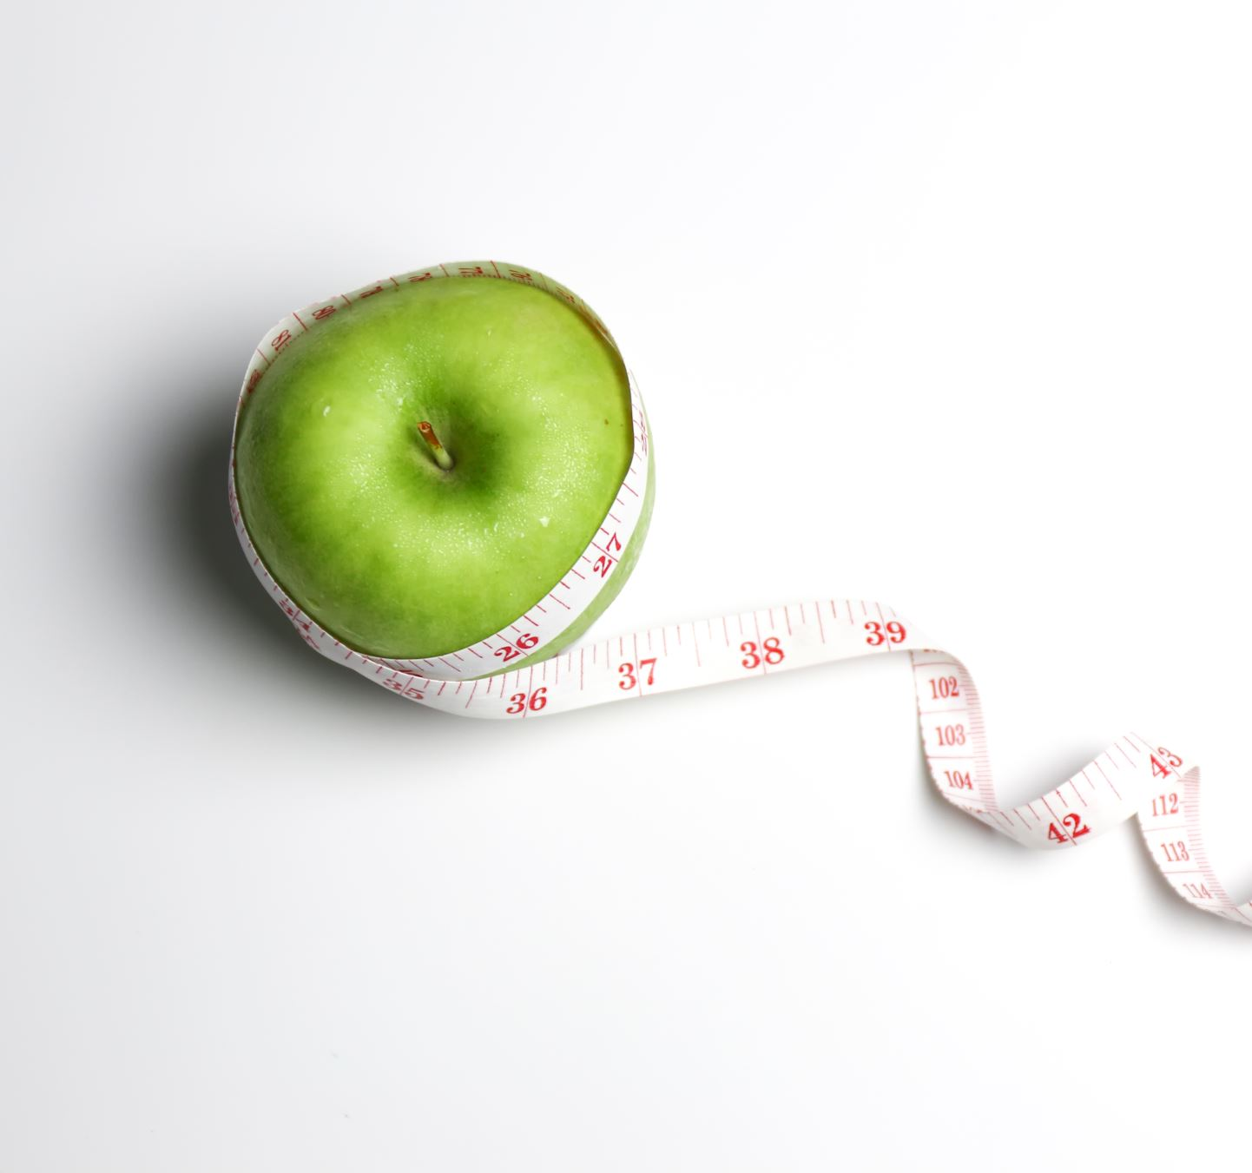
Health and Wellbeing

Slide 2
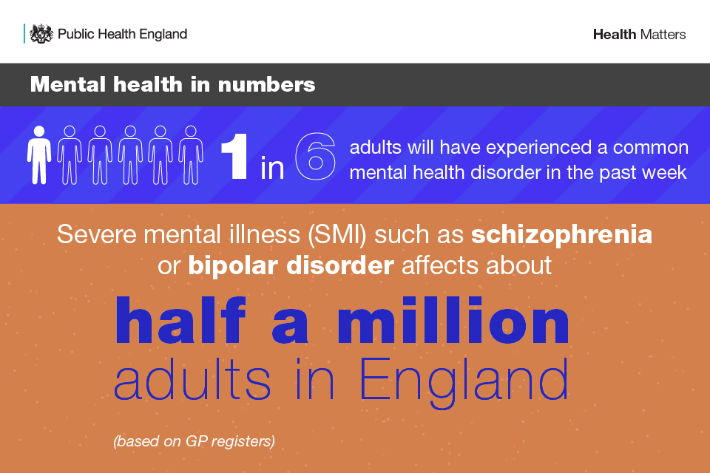
Mental health
Mental health problems are common, with 1 in 6 adults reporting a common mental health disorder, such as anxiety, and there are close to 551,000 people in England with more severe mental illness (SMI) such as schizophrenia or bipolar disorder.
Problems are often hidden, stigma is still widespread, and many people are not receiving support to access services.

Slide 3
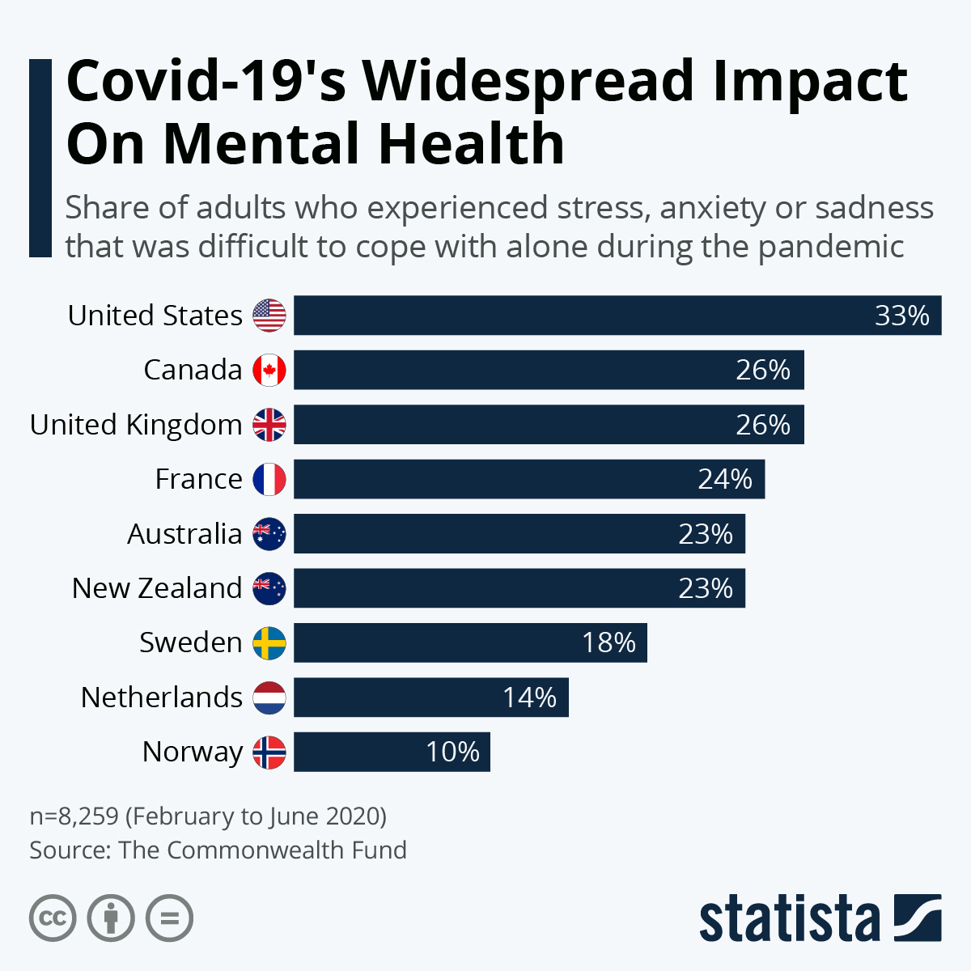
Impact of COVID-19
Public Health England has been monitoring population mental health throughout the pandemic using a range of surveys close to real-time data. This shows that self-reported mental health and wellbeing at a population level (including in anxiety, stress and depression) has worsened during the pandemic and remains worse than pre-pandemic levels.

Slide 4
What foods are good for you?
Broccoli: Broccoli provides good amounts of fiber, calcium, potassium, folate, and phytonutrients.
Apples: Apples are an excellent source of antioxidants, which combat free radicals.
Kale: Kale is a leafy green vegetable that offers a wide range of different nutrients. For example, this powerfully nutritious plant is an excellent source of vitamins C and K.
Blueberries: Blueberries provide substantial amounts of fiber, antioxidants, and phytonutrients. Unlike minerals and vitamins, phytonutrients are not essential for survival. However, they may help prevent disease and maintain vital bodily functions.
Avocados: Some people avoid consuming avocados due to their high fat content. However, avocados provide healthful fats, as well as B vitamins, vitamin K, and vitamin E. Avocados are also a good source of fiber.
Leafy green vegetables: Spinach is an example of a leafy green with antioxidant content, especially when it is raw, steamed, or very lightly boiled. It is a good source of vitamins A, B-6, C, E, and K.
Sweet potatoes: Sweet potatoes provide dietary fiber, vitamin A, vitamin C, vitamin B-6, and potassium.

Slide 5
What foods are bad for you?
Hot Dogs: Processed meats in general are just one of the worst things you can put into your body. They're high in sodium and saturated fats (not the good kind, like those found in coconut) and filled with sodium nitrite (a commonly used preservative that adds color and flavor to meats) and often other chemicals and dyes.
Pretzels: They have no fiber, no protein and no healthy fat to keep you satisfied or add health benefits to the calories you’re consuming. Instead, go for a small handful of nuts or other snacks full of fiber. Data indicates diets rich in high-fiber whole grains are associated with a lower risk of coronary heart disease (CHD) and type 2 diabetes. It’s also been shown that people who consume whole grains versus refined have better lipid profiles and glycemic control.
Diet Soda: Diet soda has also been linked to an increased risk of metabolic syndrome, when compared to regular soda. No, I'm not telling you to go grab a Sprite or regular Coke. Swap out the diet soda for club soda bubbles instead.

Slide 6
Questionnaire
https://forms.office.com/Pages/ResponsePage.aspx?id=IAGE_1JSDkqZLV4bzCrQ8IlaoYbTiBdMrVzRWO63ZaNUOVdPQ1RZMkVLMk02NjQ4MjRRVDQ0MEJWTS4u

